Slide 1

MACHINE LEARNING PROJECT
CryptoGuard
Illicit Bitcoin Transaction Detection
Detecting illicit Bitcoin transactions on the Elliptic dataset using graph features, a temporal split and eight machine learning approaches
Hagar Arafat

Slide 2
PROJECT AT A GLANCE
THE IDEA
203,769
Why This Project?
transactions analyzed
Bitcoin transactions are pseudonymous, so illicit activity hides among hundreds of thousands of legitimate ones. Checking every transaction by hand is impossible.
234,355
Our goal: build a Machine Learning model that flags which transactions are most likely illicit, so investigators can focus where it counts.
graph connections (edges)
8
models built & compared
selection metric (imbalanced data)
F1

Slide 3

THE DATASET
Features We Worked With
Elliptic Bitcoin dataset (Kaggle) — three files: transaction features, class labels and an edge list. Target column: class (1 = illicit, 2 = licit, unknown)
Transaction Features
Class Labels
Transaction Graph
203,769 transactions
167 columns: ID, time step + 165 features (time step not a model feature)
49 time steps (1 to 49)
Added feature: graph degree (166 scaled features)
Unknown: 157,205 (77.15%)
Licit: 42,019 (20.62%)
Illicit: 4,545 (2.23%)
46,564 labeled transactions
234,355 edges
Each edge links two transactions
All 203,769 transactions appear
Used to build the degree feature

Slide 4
EXPLORATION
Key Findings from the Data
1
2
3
Clean Raw Data
Mostly Unlabeled
Heavy Imbalance
No missing values, duplicates or constant features. IDs match across all three files.
157,205 of 203,769 transactions are unknown; only 46,564 carry a known label.
Among labeled transactions, 9.76% are illicit, so accuracy alone is not enough.
4
5
Time Matters
Degree Differs
49 time steps, so a temporal split is used instead of a random one.
Illicit and licit transactions show different connection patterns.

Slide 5
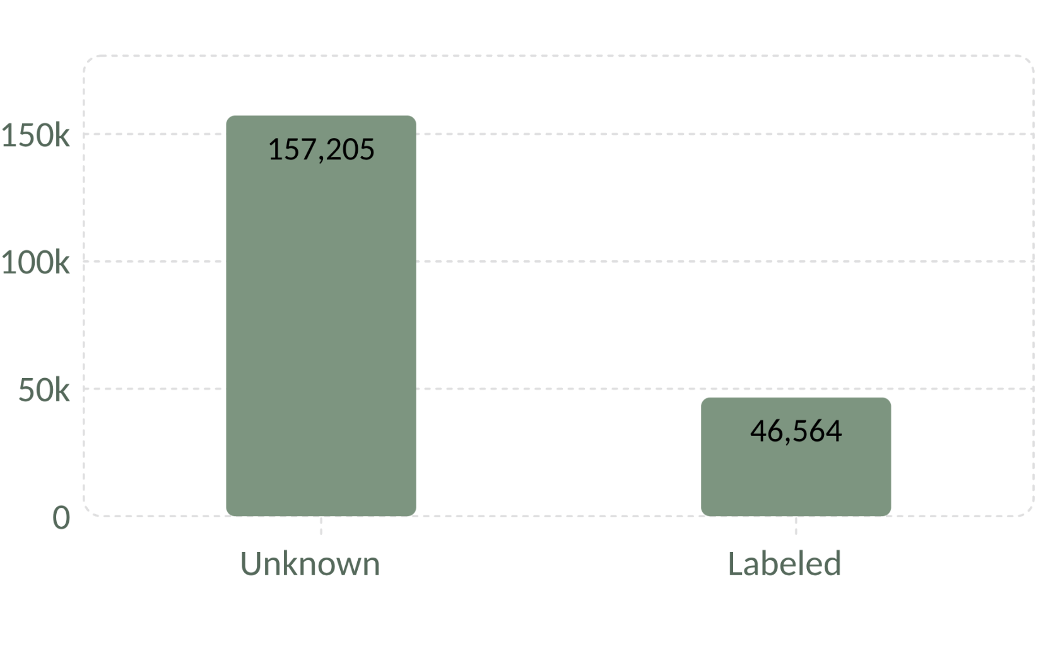
EXPLORATION
Class & Time Distribution
Labeled vs. Unknown Transactions
Train / Test Split by Time Step
Total transactions: 203,769
Labeled: 46,564 (9.76% illicit among labeled)
Unknown: 157,205
Train: time steps 1–34
Test: time steps 35–49

Slide 6
PREPARING THE DATA
Preprocessing & Feature Engineering
01
02
03
04
05
Keep Unknown Apart
Graph Degree
Temporal Split
Scale
SMOTE
Temporal degree built from edges available at each time step.
StandardScaler fit on training data only, then applied to the test set.
Training set balanced to 26,432 transactions per class.
157,205 unlabeled transactions excluded from supervised training.
Train: steps 1-34. Test: steps 35-49 (no validation set).

Slide 7
MODELING
Eight Approaches, One Goal
Scored on Accuracy, Precision, Recall, F1, ROC-AUC and PR-AUC on the final test set (steps 35-49), threshold 0.5.
Logistic Regression
Decision Tree
Random Forest
XGBoost
Linear baseline trained on SMOTE-balanced data.
Single tree, default settings.
Ensemble of 200 trees.
Gradient boosting: 200 trees, depth 6, lr 0.1.
LightGBM
Soft Voting Ensemble
Semi-Supervised RF
Isolation Forest
Fast gradient boosting with the same settings.
Unsupervised anomaly detector, 5% contamination.
Averages RF + XGBoost + LightGBM probabilities.
Adds 4,004 balanced pseudo-labeled rows.

Slide 8
RESULTS
Final Model Comparison
Final test set (time steps 35-49), sorted by F1. Soft Voting is the best supervised model.
Model | Accuracy | Precision | Recall | F1 | ROC-AUC
Semi-Supervised RF | 97.97% | 95.59% | 72.11% | 82.21% | 92.97%
Soft Voting Ensemble | 97.89% | 93.68% | 72.48% | 81.73% | 93.97%
LightGBM | 97.85% | 92.60% | 72.76% | 81.49% | 94.88%
XGBoost | 97.79% | 91.52% | 72.76% | 81.07% | 94.66%
Random Forest | 97.75% | 91.36% | 72.21% | 80.66% | 93.60%
Decision Tree | 92.35% | 44.35% | 69.99% | 54.30% | 81.94%
Logistic Regression | 76.30% | 19.62% | 85.50% | 31.91% | 88.43%
Isolation Forest* | 46.43% | 2.05% | 15.51% | 3.63% | -
*Isolation Forest is unsupervised; no ROC-AUC is reported. Threshold 0.5 for all models.

Slide 9
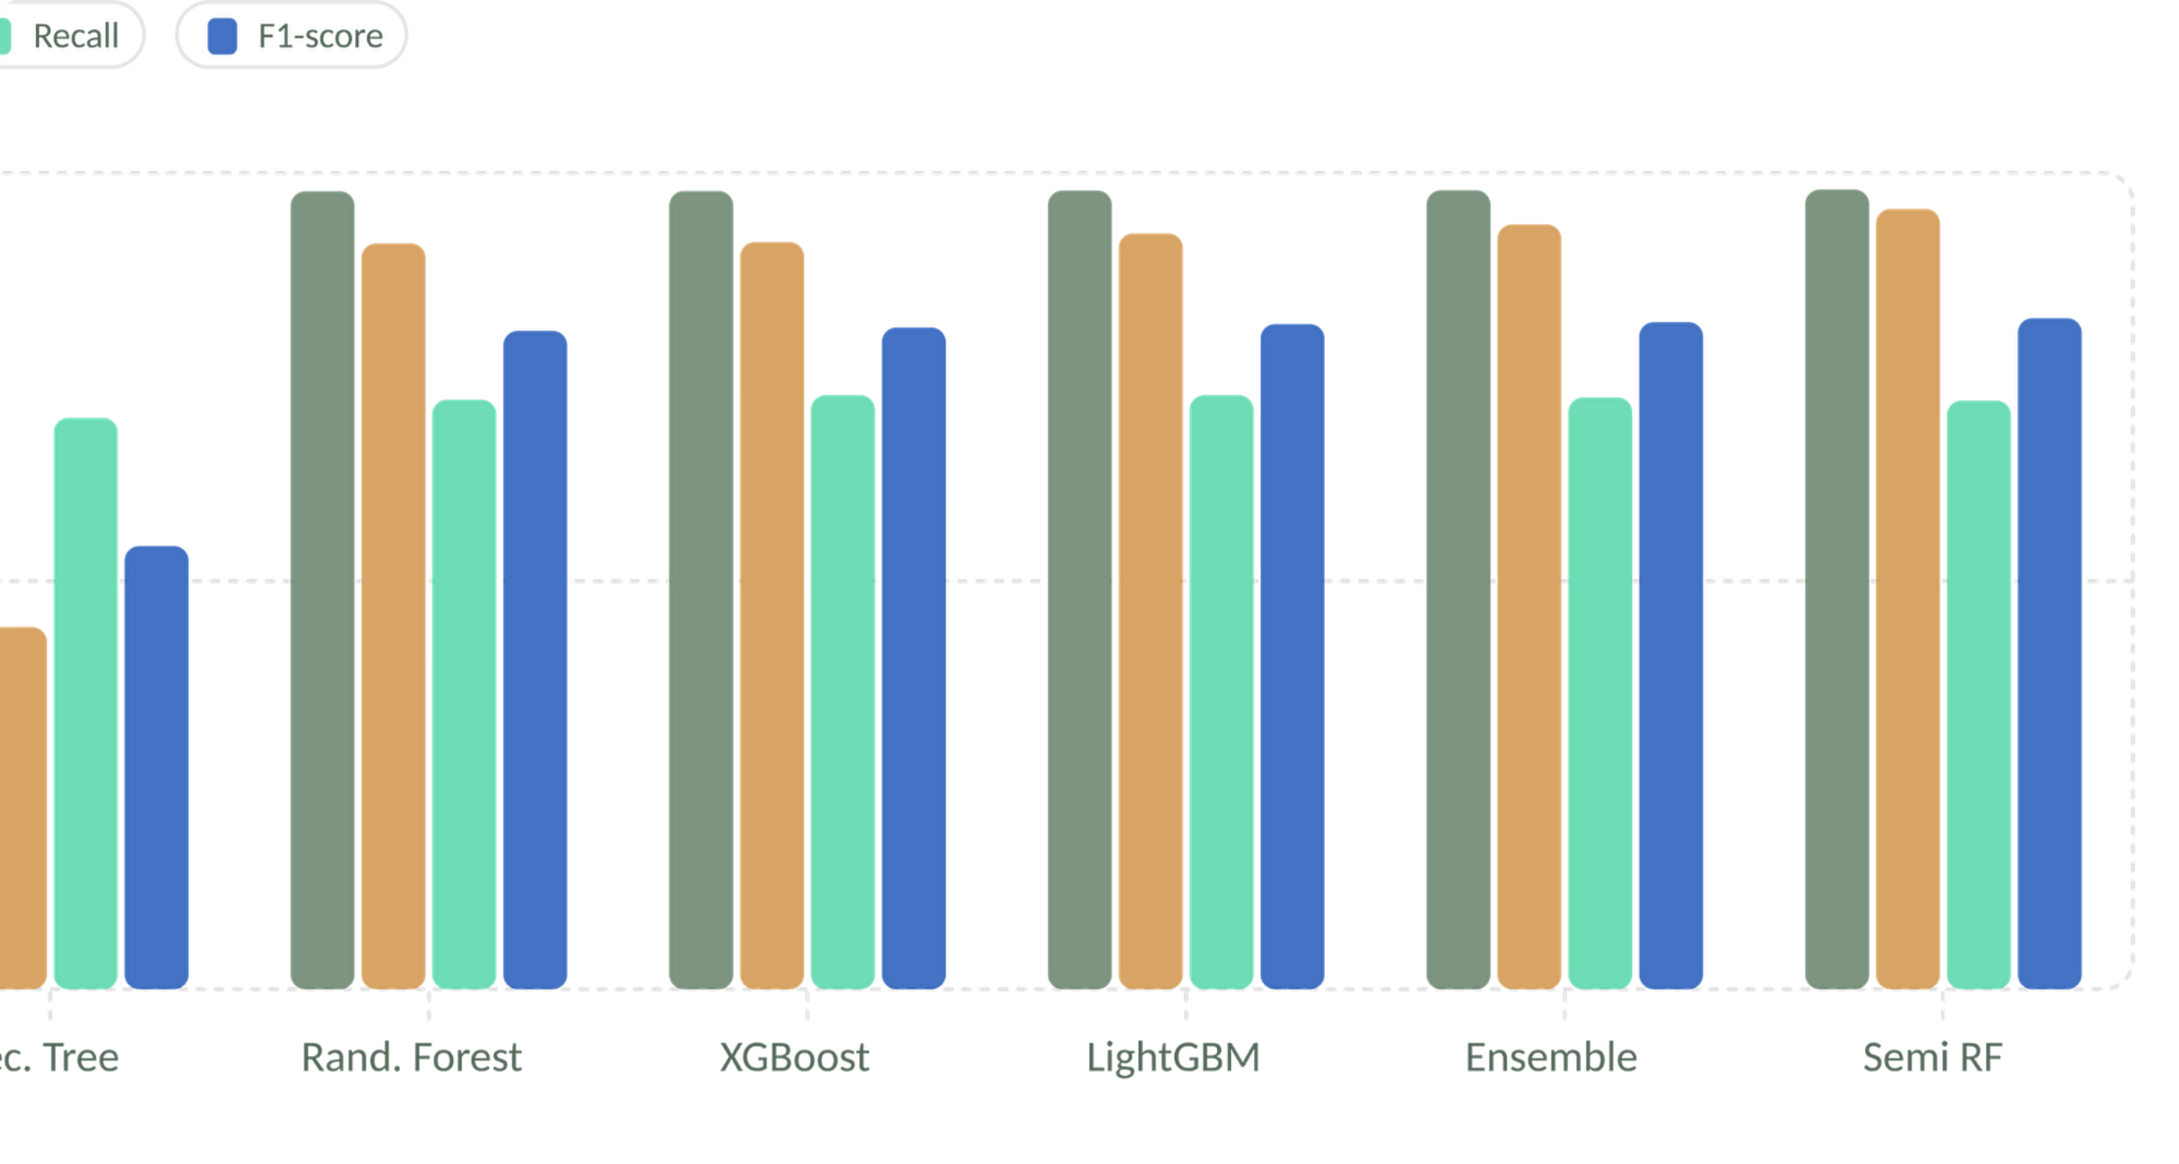
RESULTS
Model Performance at a Glance

Slide 10
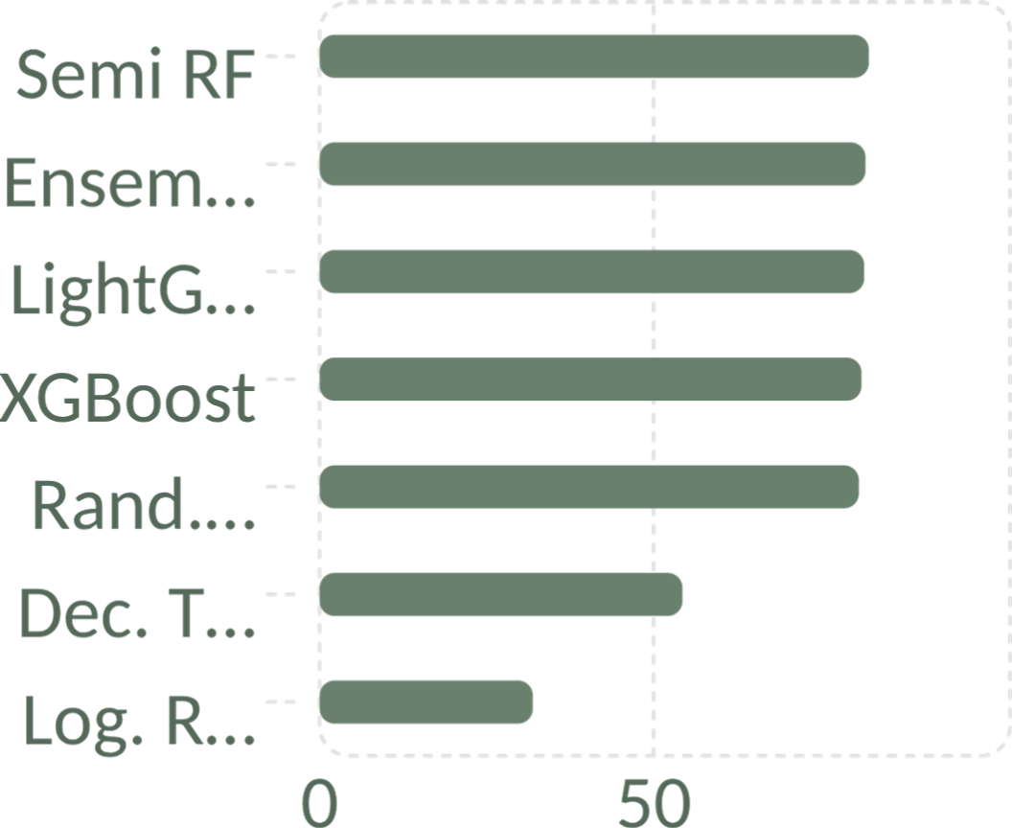
BEST SUPERVISED MODEL
Soft Voting Ensemble
Average of the illicit probabilities from Random Forest, XGBoost and LightGBM, with a fixed 0.5 threshold. Best supervised F1 on the final test set.
81.7%
72.5%
F1-score
Recall
Why F1 came first
Only 9.8% of labeled transactions are illicit, so accuracy is misleading.
F1 balances catching illicit transactions against false alarms.
Best supervised F1 (81.73%) and highest supervised precision (93.68%).

Slide 11
FINAL TEST
Generalization to the Unseen Test Set
Soft Voting catches 72.5% of illicit test transactions at 93.7% precision; semi-supervised RF reaches the top F1 (82.2%).
16,670
72.5%
93.7%
labeled test transactions, 1,083 illicit
illicit recall, Soft Voting Ensemble
precision on flagged transactions
Final Test Set
Time steps 35-49, never used for training. Threshold fixed at 0.5 and evaluated once.
Notes:
Results: 72.5% illicit recall and 93.7% precision on the untouched final test set.

Slide 12
WHY RECALL DROPPED
Distribution Shift on Later Time Steps
Performance varies across test time steps. Later steps show distribution shift, so per-step results are less stable than overall results.
1
2
Feature 104 Shifted
Recall Stays Limited
Ablation without feature 104: F1 81.41%, ROC-AUC 94.33%, close to the full ensemble.
Most test steps hold few illicit transactions, so per-step recall swings widely.
Illicit Recall Across Test Time Steps

Slide 13
UNDER THE HOOD
Pipeline
Model Pipeline
1
2
Load the 3 Elliptic files and verify integrity
Audit missing values, duplicates and classes
3
4
Engineer temporal degree from the edge list
Temporal split: train steps 1-34 / test steps 35-49
5
6
StandardScaler (fit on train) + SMOTE
Train 5 supervised models + soft voting ensemble
7
8
Pseudo-label unknowns + Isolation Forest
Evaluate once on the unseen test set (threshold 0.5)

Slide 14
THANK YOU
Hager Arafat
EL Dabaa
CryptoGuard: Illicit Bitcoin Transaction Detection
Notes:
Thank you. CryptoGuard detects illicit Bitcoin transactions; questions welcome.

